Slide 1
Team 23: 2D Object Detection using YOLOv3 on Waymo Open Dataset
By Revanth Sakthivelan, Saloni Jain, Divyansh Agarwal
12200843 12203853 12102620
Notes:
Divyansh

Slide 2

Motivation
Autonomous Cars!
Developments by Waymo in this field and their vast Dataset available for free.
Opportunity to search and work on state of the art object detection algorithms.
https://waymo.com/open/
Notes:
Divyansh

Slide 3
Object Detection Overview
Object Detection is a very vital part of autonomous driving system.
It can be performed using 2D images or 3D LiDAR data.
Convolutional neural networks are exceptional at 2D Object Detection with images.
The main objective of the convolutional neural network is to predict the bounding boxes and the type of objects in the images.
The convolutional neural network requires massive amounts of labelled images during the training phase.
Once trained, the convolutional neural network is capable of predicting objects in images in real time.
Notes:
Divyansh

Slide 4
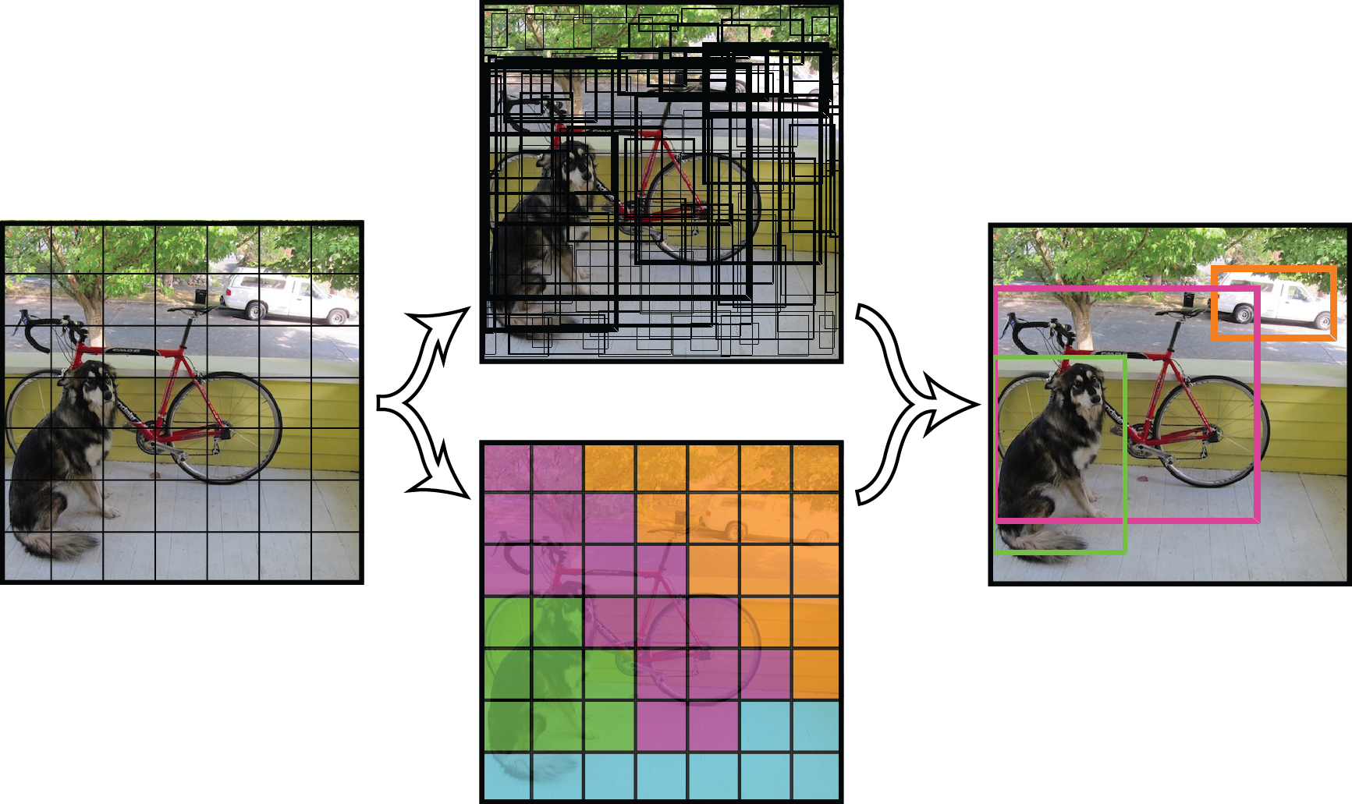
YOLO Overview
YOLO stands for “You Only Look Once”. This name is used to highlight the distinction between it and other object detection models.
While other models require multiple passes through the image before generating a prediction, YOLO divides the image into grids, with each grid having a certain number of anchors that can make a detection.
Notes:
Saloni

Slide 5
YOLO Overview
YOLO considers each image in its entirety, rather than using the sliding window approach and it frames object detection as a regression problem with a fixed set of parameters per image.
Once trained, YOLO can make inferences very quickly. It is fast enough to detect objects in a video in real time.
It predicts the centre coordinates, width, height, object confidence and object class when it detects an object.
YOLO uses the concept of anchor boxes, which allows it to make multiple predictions per grid cell, on potentially overlapping objects.
The anchors are a fixed number of boxes set to fixed dimensions.
Drawbacks of YOLO are that it has trouble detecting small objects, and when it does detect an object it often creates a bounding box with not enough overlap with the true object.
Notes:
Saloni

Slide 6
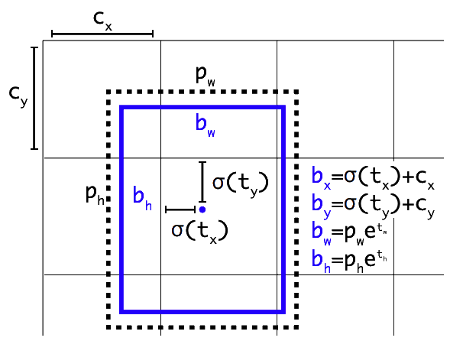
YOLOv3 Overview
YOLOv3 is very fast and accurate in terms of mean average precision (mAP) and Intersection over Union (IoU) or the The Jaccard index compared to its previous version and other detection models.
YOLOv3 model works better on smaller objects and creates more accurate bounding boxes around the objects.
YOLOv3 uses Darknet-53 as the backbone feature extractor, compared to Darknet-19 used by YOLOv1 and YOLOv2.
Notes:
Saloni

Slide 7
Waymo Open Dataset
The Waymo Open Dataset comprises of high resolution sensor data of 2D images collected by autonomous vehicles in a wide variety of weather conditions.
It consists of synchronised LiDAR, camera data, 200k object frames with 2D key point labels, sensor calibrations and vehicle poses.
The object classes to be predicted from the Waymo dataset are vehicles, pedestrians, cyclists and road signs.
The dataset is generally enough for any machine learning algorithm to extract the relevant data for 2D object detection.
Notes:
Revanth

Slide 8
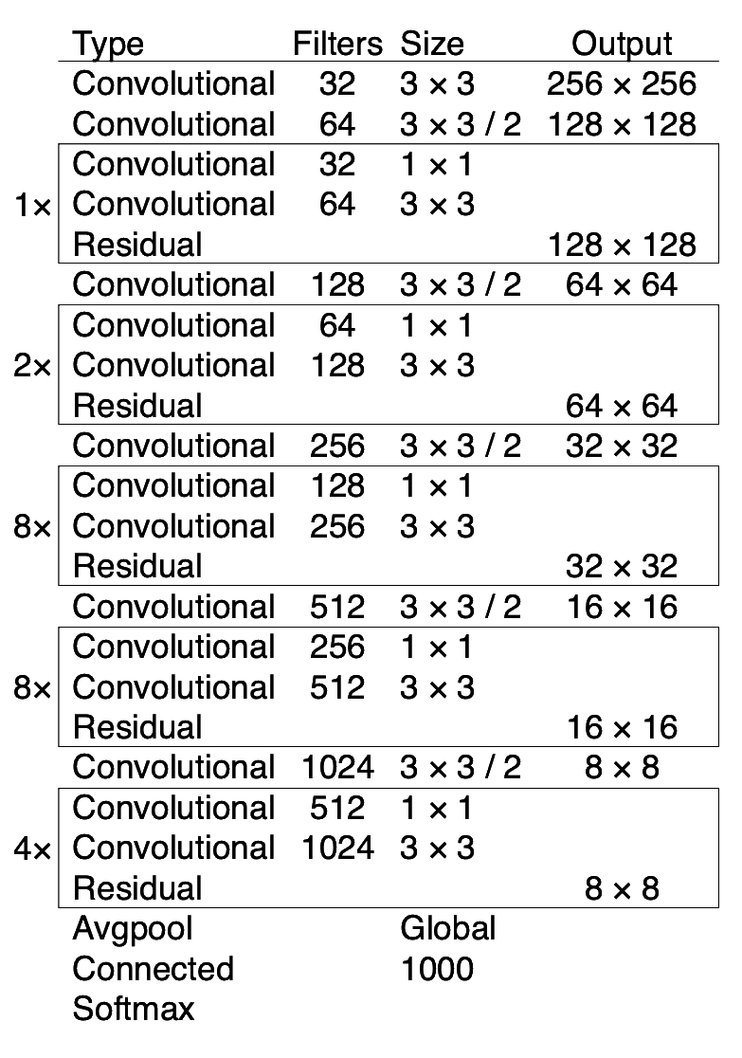
Darknet-53 Overview
Darknet-53 is a deep convolutional neural network consisting of 53 layers.
Each layer has alternating filter sizes and as the network progresses in depth, its width and height get smaller.
Batch normalization and max pooling are used throughout the network.
Notes:
Revanth

Slide 9
Darknet-53 Overview
Consider layers in each rectangle as a residual block.
The whole network is a chain of multiple blocks with some Convolutional layers using stride two in between to reduce dimension.
Inside the block, there’s just a bottleneck structure (1x1 followed by 3x3) plus a skip connection.
Notes:
Revanth

Slide 10
Darknet-53 Overview
An average pooling and a 1000 ways fully connected layers along with softmax activation is used.
The activation function used is LeakyRelu.
The network generates a 4D output volume corresponding to the grid, anchors, and prediction values we are interested in. The output is (grid_height, grid_width, num anchors, num_predictions).
Notes:
Revanth

Slide 11
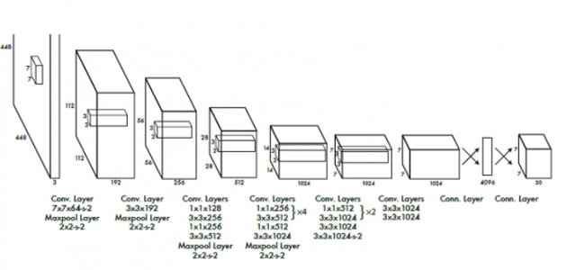
Network Architecture
Notes:
Revanth

Slide 12
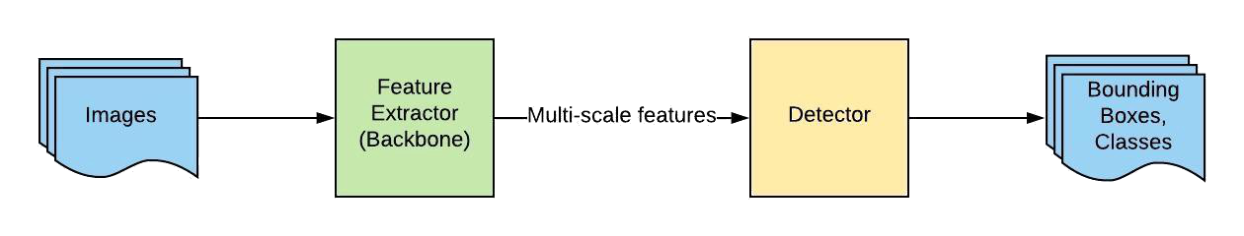
Network Architecture
The model uses L2 regularizer and adam optimizer.
Inspired by the GoogleNet architecture, YOLO’s architecture has a total of 24 convolutional layers with 2 fully connected layers at the end.
The algorithm applies a single neural network to the entire full image. Then this network divides that image into regions which provides the bounding boxes and also predicts probabilities for each region.
Notes:
Revanth

Slide 13
Code
Notes:
Revanth

Slide 14
Lessons Learned
At 320 x 320 resolution, YOLOv3 runs in 22ms with 28.2 mAP (mean average precision).
The algorithm understands generalized object representation which allows them to train the network on real world images and predictions are still fairly accurate.
YOLO reasons globally about the image when making predictions. Unlike sliding window and region proposal-based techniques, YOLO sees the entire image during training and test time so it implicitly encodes contextual information about classes as well as their appearance.
Notes:
Divyansh

Slide 15
Limitations
Although YOLOv3 can predict images at high frame rates, it struggles with videos. Since we need to consider filtering, prediction, smoothing, most likely explanation and learning for motion videos.
Since our model learns to predict bounding boxes from data, it struggles to generalize to objects in new or unusual aspect ratios or configurations.
while we train on a loss function that approximates detection performance, our loss function treats errors the same in small bounding boxes versus large bounding boxes. A small error in a large box is generally benign but a small error in a small box has a much greater effect on IoU. Our main source of error is incorrect localizations.
Notes:
Divyansh

Slide 16
References
YOLOv3: An Incremental Improvement by Joseph Redmond and Ali Farhadi. https://arxiv.org/pdf/1804.02767v1.pdf
Dive Really Deep into YOLO v3: A Beginner’s Guide by Ethan Yanjia Li. https://towardsdatascience.com/dive-really-deep-into-yolo-v3-a-beginners-guide-9e3d2666280e
2D Detection on Waymo Open Dataset by Andreas Peeter Lätt. https://medium.com/@lattandreas/2d-detection-on-waymo-open-dataset-f111e760d15b

Slide 17
Thank you!
Any question?

